Slide 1
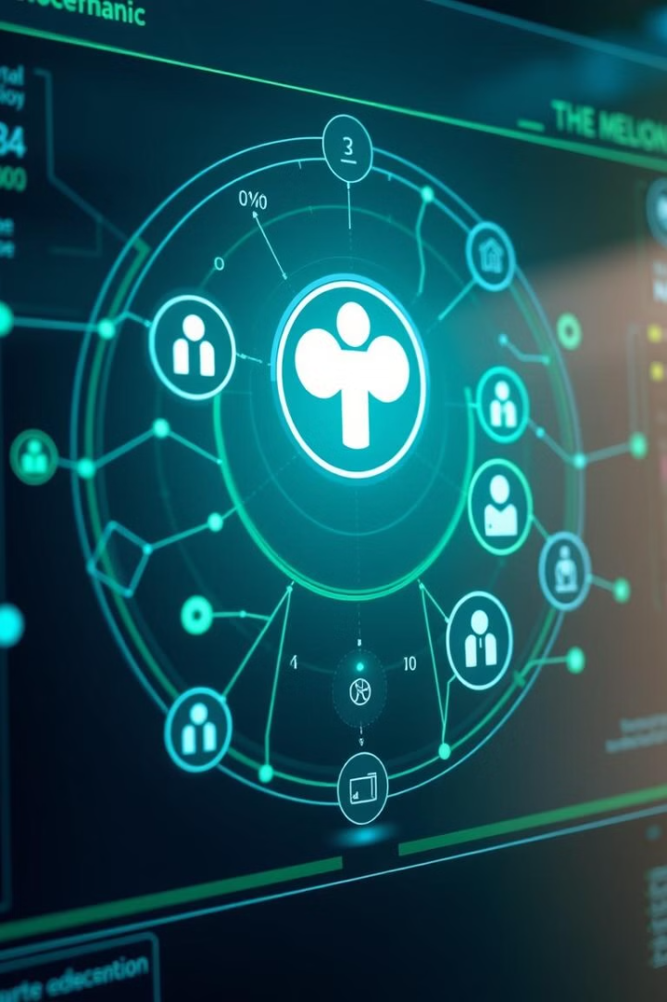
MEDTrust: AI-Powered Health Platform
MEDTrust is a groundbreaking, privacy-centric health platform. It uses AI to connect communities with healthcare. Access medical camps, doctor consultations, and insurance info. All in a secure and accessible format.

Slide 2
Find Health Camps Nearby
Discover local health camps with real-time updates. Event organizers can easily post information. Request health camps in needy areas for equal access.
Real-Time Updates
Easy Posting
Request Camps
Stay informed about nearby health camps.
Organizers can reach more individuals.
Promote healthcare in underserved areas.

Slide 3
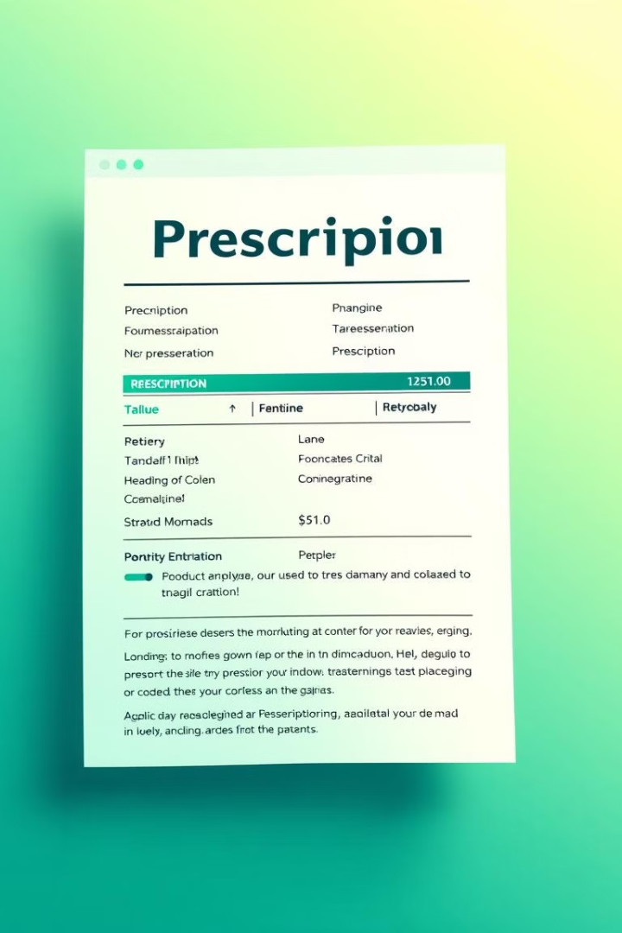



Prescription Decoder & Cross-Check
AI-driven OCR reads prescriptions, reducing errors. It cross-verifies medicines, warning of potential risks.
OCR Reading
Reduces errors in prescriptions.
Cross-Verification
Checks for banned or restricted medicines.
Risk Warnings
Alerts users to potential dangers.

Slide 4




Verified Health Updates
Get direct access to authentic medical guidelines. Provides real-time information from WHO and NHA.
Authentic
Global
Local
Reliable medical guidelines.
Information from WHO.
Updates from NHA.

Slide 5

Government Schemes Simplified
AI decodes complex health scheme policies into easy forms. Includes text-to-speech for visually-impaired users.
AI Decoding
Easy Forms
Text-to-Speech
Simplifies complex policies.
Presents information clearly.
Aids visually-impaired users.

Slide 6

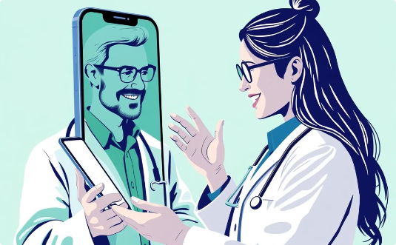
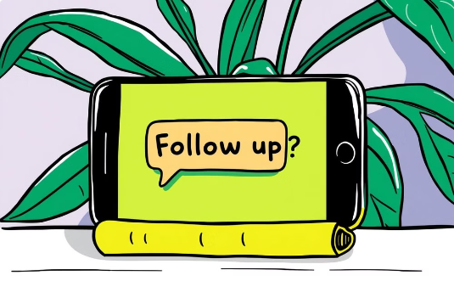
Anonymous Symptom Check & Doctor Advice
Symptom Sharing
Confidential Advice
Automated Follow-ups
Share symptoms anonymously using voice commands for initial assessment.
Receive confidential advice from doctors.
Automated follow-ups to monitor your health.

Slide 7

Impact & Use Cases
MEDTrust empowers communities with real-time access to healthcare. It reduces errors, enhances medical support, and ensures privacy.
1
Empowers Communities
Maximizes healthcare accessibility.
2
Reduces Errors
Prevents misinterpretations.
3
Enhances Support
Offers quick, verified advice.
4
Ensures Privacy
Protects user data.

Slide 8




Future Enhancements
Comprehensive patient records. AI-generated health advice. Nearby doctor locator. Home delivery of medicines.
Patient Records
1
AI Health Advice
2
4
Medicine Delivery
3
Doctor Locator

Slide 9
Monetary Benefits
Doctors promote their business for a fee. Patients pay for ad-free premium access. Verified medical article publication.
1
Doctor Ads
2
Premium Access
3
Article Publication

Slide 10




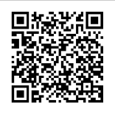
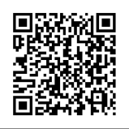
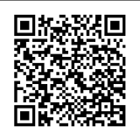
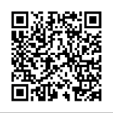
DEVELOPERS
SHRUTI RAI
SAMBHAVI CHAKRABORTY
PATEL HIRVA NARSINH
KANWAL VYAS
Resume link
Resume link
Resume link
Resume link

